Slide 1
Module 6 : Models of care delivery

Slide 2
Learning Objectives
Recognise the role of decentralised care, including community care, in increasing access to care and ensuring continuity of TB services for children and adolescents.
Understand the implementation considerations for setting up decentralised care.
Recognise the role of the private sector in improving access to TB care services.
Understand the role of differentiated service delivery models for improving access to TB care services.
Notes:
Decentralised approaches to care aim to provide child and adolescent TB care services at a lower level of the healthcare system than is currently being provided- including primary care and community levels. These approaches aim to bring TB services closer to where children and adolescents seek care and where families that care for these children live. Decentralised approaches to care are essential to achieving universal health coverage which is the aspiration that everyone should receive good quality health services, when and where needed, without incurring financial hardship.
In this module, you will learn about the role of decentralised care in increasing access to and ensuring continuity of child and adolescent TB care services, the implementation considerations for decentralised care and the role of the different players e.g., the private sector in the delivery of decentralised care.

Slide 3
Outline
Introduction and universal health coverage (UHC)
Rationale for alternative models of care
Decentralised care
Integrated family-centred care
Community-based care
Private sector engagement
Differentiated service delivery models
Case study: designing a decentralised model for a TB programme
Conclusion
Notes:
In this module, we will start with Introduction and universal health coverage, then I will talk about different care delivery models. I will start with decentralised care, then discuss the importance of integrated family-centered care. I will then talk about the role of community-based care services and the private sector in expanding the reach of healthcare services to all patients. Finally, I will talk about differentiated service delivery models of care for children co-infected with TB and HIV. At the end of the module, we will have a case discussion where we will have the opportunity to design a decentralised care model for a TB programme. We will then conclude this module.

Slide 4
Outline
Discussion
Introduction and universal health coverage (UHC)
Rationale for alternative models of care
Decentralised care
Integrated family-centred care
Community-based care
Private sector engagement
Differentiated service delivery models
Case study: designing a decentralised model for a TB programme
Conclusion
Discussion
Discussion
Notes:
At the beginning of this module, you will have an opportunity to share some of your own country specific practices with different models of care delivery

Slide 5
Discussion – setting specific practices
Note to facilitator:
Suggested instructions:
These context specific discussion opportunities will occur repeatedly throughout this training. Here are some suggestions on how you might like to facilitate them, to run them in a time efficient manner.
Explain that the next 15 minutes will be devoted to sharing amongst your colleagues, about how things may work in your setting.
Explain that 3, or 4, questions will be shown on the presentation.
Then divide the questions amongst the groups. Some groups may need to discuss the same question.
Tell them they will have just 2 or 3 minutes to discuss in their small groups. Then you will discuss as a large group.
Allow 2-3 minute discussion time.
When this time is up, ask for everyone’s attention. And then ask for volunteers to comment on each question discussed. Request participants to keep their responses succinct so that the time allows for others to also contribute.
Acknowledge all responses and thank participants for sharing.
Be mindful of the time and try to wrap up discussions so that the full activity takes no more than 15 minutes.
Click for audible instructions
To discuss Question 1
To discuss Question 4
To discuss Question 2
To discuss Question 3
Notes:
These context specific discussion opportunities will occur repeatedly throughout this training.
Here are some suggestions on how you might like to facilitate them, to run them in a time efficient manner.
Explain that the next 15 minutes will be devoted to sharing amongst your colleagues, about how things may work in your setting.
Explain that 3, or 4, questions will be shown on the presentation.
Then divide the questions amongst the groups. Some groups may need to discuss the same question.
Tell them they will have just 2 or 3 minutes to discuss in their small groups. Then you will discuss as a large group.
When this time is up, ask for everyone’s attention. And then ask for volunteers to comment on each question discussed. Request participants to keep their responses succinct so that the time allows for others to also contribute.
Acknowledge all responses and thank participants for sharing.
Be mindful of the time and try to wrap up discussions so that the full activity takes no more than 15 minutes.

Slide 6
Discussion: Models of care delivery
How do you define universal access to TB care in your setting?
1
What are the different ways decentralised care is delivered in your setting?
2
What are the advantages of decentralised care?
3

Slide 7
How do you define universal access to TB care in your setting?
1
What are the different ways decentralised care is delivered in your setting?
2
What are the advantages of decentralised care?
3

Slide 8
Introduction

Slide 9
Introduction and Universal Health Coverage
Introdand UHCuction
WHO (2022) recommends that varying models of care delivery should be implemented to increase access to TB care for children and adolescents in high TB burden settings.
DECENTRALISED CARE
INTEGRATED FAMILY-BASED CARE
RIGHT CARE
RIGHT PLACE
RIGHT TIME
RIGHT WAY
PRIVATE SECTOR ENGAGEMENT
DIFFERENTIATED SERVICE DELIVERY
COMMUNITY-BASED CARE
Notes:
Universal health coverage (UHC) means that all people have access to the full range of quality health services they need, when and where they need them, without financial hardship. To achieve this, healthcare systems must move away from a “one-size-fits-all” model of healthcare delivery to models that align health service delivery to the needs and preferences of varying individuals and communities.
This module focuses on different healthcare delivery models which aim to increase access to child and adolescent TB services. These include
Decentralised care: delivery of child and adolescent TB screening, diagnosis and treatment services at lower levels of the healthcare system than they are currently being delivered e.g., at primary care facilities or community pharmacies.
Integrated family centred care: family centred care is a model of care where care is “planned around the whole family, not just the individual child/person receiving care. It refers to the integration of TB screening, prevention and diagnosis with other existing service delivery platforms for other family members e.g., maternal and child health (such as antenatal care, iCCM, IMCI) as well as other related services (such as HIV, nutrition, immunisation).
Community-based care: the delivery of selected TB care services within the patients’ home or community. Community-based care is usually delivered by lay healthcare workers and includes services like health education, treatment adherence support and contact investigation.
Private sector engagement: training of healthcare workers who deliver care in outside the public sector in the delivery of TB care services. This often includes healthcare workers in private clinics, community pharmacies/dispensaries and may also include alternative care providers e.g., traditional healers.
Differentiated Service Delivery models for key populations e.g., children and adolescents co-infected with HIV: This refers to the provision of HIV services in ways that better serve the needs of people living with HIV and reduce unnecessary burdens on the health system. DSD models include interventions like multi-month refills, nurse visits, and community drug refills.

Slide 10
Rationale for alternative models of care delivery

Slide 11
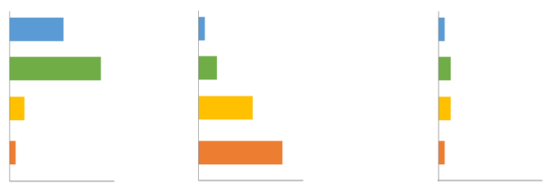
Rationale for alternative models of care delivery
Hanson C, Osberg M, Brown J, Durham G, Chin DP. Finding the missing patients with tuberculosis: lessons learned from patient-pathway analyses in 5 countries. The Journal of infectious diseases. 2017 Oct 1;216(suppl_7):S686-95..
Notes:
Understanding how and where patients seek health care services is the first step to planning for improved access to care. Patient pathway analyses describe the steps taken by patients with TB take from initial care seeking to cure and contrast these with the availability of TB services at each level of the healthcare system.
The first column shows where patients initiate their care-seeking journey across different sectors and levels of the healthcare system. The second column estimates the percentage of health facilities at each level with TB diagnostic services. The third column estimates the likelihood that a patient will start their care-seeking journey at a facility that has TB diagnostic tools available. This is calculated by multiplying the share of patients who seek care (column 1) at each sector and percentage of health facilities at each level with TB diagnostic services.
Recent results from patient pathway analyses in five high TB burden countries in Asia and Africa are shown on this slide. These results showed that 40% patients with TB initiate care seeking at Level 0 health facilities (community pharmacies/dispensaries) where only 13% have TB diagnostic capacity. Another 50% initiate care seeking from Level 1 health facilities (private or public primary care facilities) where only 39% have TB diagnostic capacity. The remaining 10% initiated care at Level 2 and 3 health facilities ( hospitals) although the majority of these had TB diagnostic services. In addition, 66% of patients initially sought care in private facilities, which had considerably less tuberculosis diagnostic capacity than public facilities; This mismatch between service availability and healthcare seeking behaviour resulted in only 24% of patients initiating care seeking in a facility with tuberculosis diagnostic capacity.

Slide 12
Rationale for alternative models of care delivery
Hanson C, Osberg M, Brown J, Durham G, Chin DP. Finding the missing patients with tuberculosis: lessons learned from patient-pathway analyses in 5 countries. The Journal of infectious diseases. 2017 Oct 1;216(suppl_7):S686-95..
Notes:
Alternative models of care delivery e.g., decentralised care and engagement of the private sector can better align availability of TB services to places where patients seek care and increase access to TB care.
This slide shows that decentralising diagnostic and treatment services and increasing coverage at lower level facilities will result in much greater access to services for people with TB.

Slide 13
Decentralised care

Slide 14
Structure of decentralised care
Community
Primary care facility
Referral hospital
Household contact screening
Patients with TB
Diagnosis and initial management of
Severe disease
Complicated disease
Drug-resistant TB
Diagnostic evaluation
(Specimen collection and
X-rays if indicated and access)
Treatment initiation
Symptomatic contacts (all ages)
Asymptomatic contacts
(< 5 years old or HIV-positive)
Initiation of TPT
Follow up
Adopted from Dongo JP, Graham SM, Nsonga J,et al. Implementation of an Effective Decentralised Programme for Detection, Treatment and Prevention of Tuberculosis in Children. Trop Med Infect Dis. 2021 Jul 14;6(3):131. doi: 10.3390/tropicalmed6030131. PMID: 34287383; PMCID: PMC8293469.
Notes:
Decentralised care is the delivery of child and adolescent TB screening, diagnosis and treatment services at lower levels of the healthcare system e.g., at primary care facilities or community pharmacies where children with TB and their families initiate TB care seeking.
The implementation of decentralised care varies based on local TB burden, available resources, existing infrastructure and the regulatory framework in each country. However, decentralised models of care generally aim to
improve the capacity of primary care healthcare workers to undertake clinical assessment and diagnostic evaluation of children and adolescents with presumptive TB and to initiate treatment for those diagnosed with TB.
create linkages between the primary levels of care and tertiary levels of care as well as community-based care services to allow for continuity of care.
In a properly functioning decentralised care model, children and adolescents with symptoms and signs of TB are referred from the community to the primary care facility for diagnostic work up and initiation of TB treatment or TB preventive therapy. If these children have severe disease or comorbidities, they are then referred to tertiary levels for initial management of severe TB disease and comorbidities. Long term follow-up of these children and adolescents (for contact tracing, counselling on adherence to TB treatment and monitoring of adverse drug reactions) is often carried out at the community level.

Slide 15
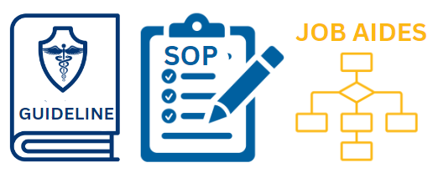
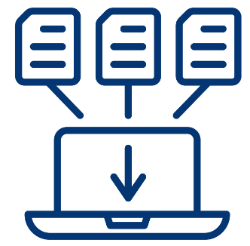
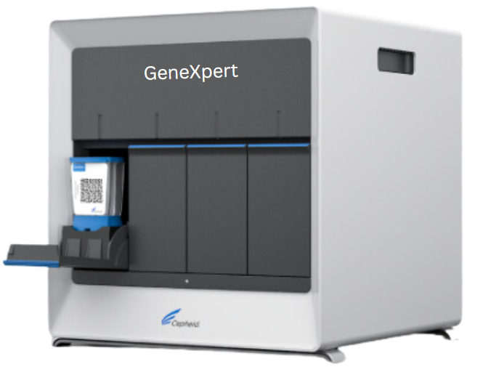
Implementation considerations
Regulatory frameworks and policies | Stakeholder engagement | Skilled workforce
Access to quality diagnostics | Availability of child-friendly TB medicines | Health information management tools
Notes:
Interventions for decentralisation of child TB and adolescent TB treatment and prevention services often include:
Setting up of regulatory frameworks and policies to support the implementation of decentralised and integrated care. This may call for development or update of implementation guidelines, standard operating procedures and job aides
Conducting stakeholder engagement meetings with other programmes that provide care for children and adolescents, e.g., maternal and child health, HIV and nutrition and adolescent/youth friendly services. This helps identify service delivery points into which child TB services can be integrated.
Ensuring availability of a skilled workforce to provide high quality TB services. This often includes capacity building (training, onsite mentorship and continuous supportive supervision) of healthcare workers at the primary care levels to prepare them to take on additional tasks. The NTPs should also plan for task shifting of “simpler” tasks, e.g., TB screening, contact investigation, non-invasive sample collection to expand the health workforce available.
Ensuring access to quality diagnostics–including availability of WHO recommended molecular diagnostics- at all levels of the healthcare system. This can be achieved through specimen transportation systems.
Securing availability of TB medicines for children and adolescents -including child friendly formulations for both TB disease and TB preventive therapy at all levels of the health care system
Ensuring availability of health information management tools (recording and reporting tools) at all levels of the healthcare system

Slide 16
Advantages of decentralised models of care
Rationale for decentralisation
Increased and earlier detection of TB for improved outcomes.
Integrate treatment support – families/households.
Reduce care-seeking costs and unnecessary referrals with reduced costs for families and health systems.
Implement community-based contact screening and management:
Active case detection
Support TPT among eligible contacts
Support adherence to treatment for disease and infection
Notes:
The implementation of decentralised TB care services has many advantages:,
Increased access to TB care services results in earlier detection of TB with improved treatment outcomes.
In addition, provision of care at primary care facilities provides opportunities for integration of TB and other childcare services e.g., HIV care and nutrition services resulting in improvements in utilisation of all services and reducing costs associated with seeking care. I
ntegration with community interventions, e.g., contact screening and treatment adherence support improves uptake of TB preventive therapy and completion of treatment for both TB disease and infection.

Slide 17
Discussion: Models of Care Delivery
What is the role of the community-based care and the private sector in the delivery of child and adolescent TB care services in your country?
1
What are the different special groups of children and adolescents for whom you could design differentiated service delivery models?
2
What types of differentiated service delivery models would suit these different groups?
3

Slide 18
What is the role of the community-based care and the private sector in the delivery of child and adolescent TB care services in your country?
1
What are the different special groups of children and adolescents for whom you could design differentiated service delivery models?
2
What types of differentiated service delivery models would suit these different groups?
3

Slide 19
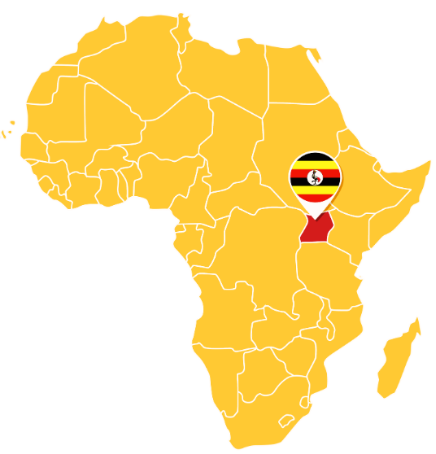
Example of decentralisation of child TB services
DETECT project implemented in one rural and one urban district of Uganda.
Adapted The Union Child TB training materials to the Uganda setting
Trained primary care workers in the systematic evaluation of children and adolescents
presenting with signs and symptoms of TB –including clinical diagnosis.
Carried out periodic onsite mentorship to reinforce new skills.
Implemented health system strengthening to ensure availability of diagnostic tools, medicines and Established community systems for TB contact tracing, TPT initiation and TB treatment adherence support
Project outcomes:
Increased numbers of children (by 140%) diagnosed and treated for TB in intervention districts.
Increase in case detection of adults with TB (by 30%).
Improved treatment outcomes in children: treatment success from 65% pre- to 82% post-implementation.
Successful introduction by community health workers of integrated household screening with high TPT uptake (77%) and completion (85%).
Successful scale up to ten other districts in Uganda after the first two years and eventually to the rest of the country.
Uganda
Zawedde-Muyanja S, Nakanwagi A, Dongo J, et al. Decentralisation of child tuberculosis services increases case finding and uptake of preventive therapy in Uganda. Int J Tuberc Lung Dis. 2018 Nov 1;22(11):1314-1321. doi: 10.5588/ijtld.18.0025. PMID: 30355411; PMCID: PMC7237826.
Notes:
The DETECT Child TB project was implemented in Uganda from June 2015 to December 2016. Prior to its implementation, only 8% of total TB case notifications in Uganda were children of 0-14 years of age. In addition, the screening and management of child household contacts of TB cases was not routinely implemented at the time.
The Union Country Office in Uganda working collaboratively with the Uganda NTLP developed training materials on child TB which emphasised a systematic approach to TB diagnosis in children that includes careful clinical evaluation for TB-related symptoms and signs, history of TB contact, and where possible, investigations for bacteriological confirmation. The project then trained healthcare workers at primary care facilities in two districts to screen, diagnose and treat TB in children. Training was followed by on-site mentorship to reinforce new knowledge and skills gained, as well as adherence to the national guidelines. Supportive supervision addressed health system challenges and ensured availability of medicines as well as recording and reporting tools. The project also trained community healthcare workers to carry out household contact screening of child contacts of patients diagnosed with TB with referral of asymptomatic children to health facilities for TPT initiation.
By the end of 18 months, the number of children started on TB treatment had more than doubled in both districts and treatment outcomes for both children and adults had improved. In addition, TPT uptake and completion improved in both districts.

Slide 20
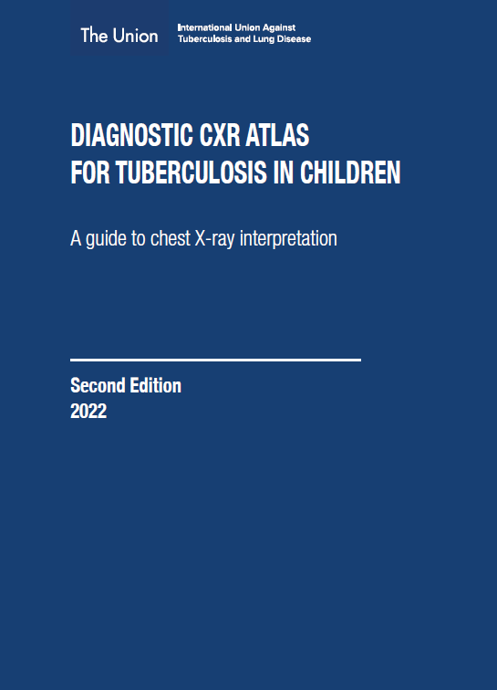
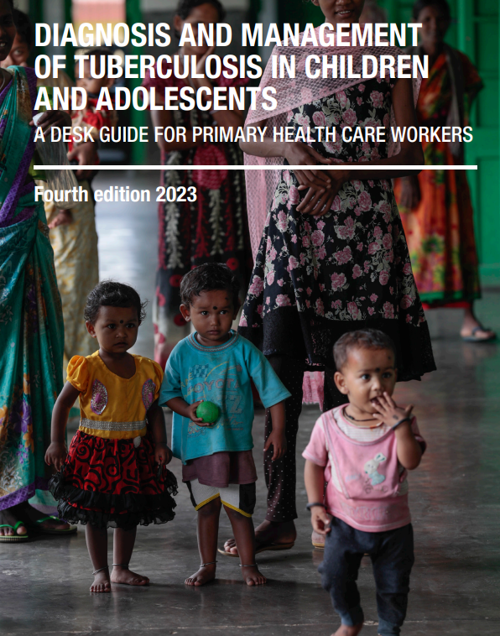
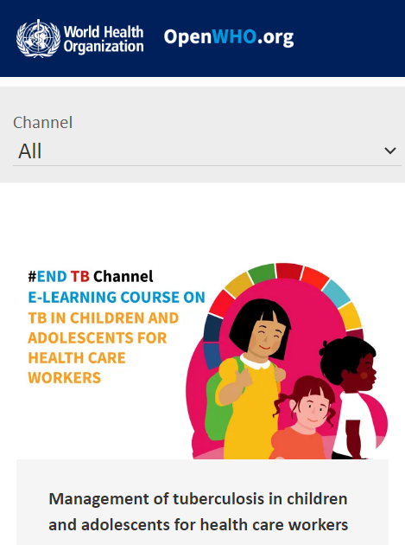
E-learning, guides and job aides to support decentralised care
Notes:
There are several e-learning guides and job aides available to support countries that want to implement decentralised child TB services. These guides are available through both the WHO and The Union websites.
The WHO e-learning course on the management of tuberculosis in children and adolescents gives practical guidance on key elements of the management of TB in children and adolescents and ensuring access to quality care. The role of health care workers in screening, preventing, diagnosing, and managing TB in children and adolescents is critical.
The WHO operational handbook on tuberculosis is the practical implementation guide to the 2022 WHO guidelines on the management of tuberculosis in children and adolescents. This handbook gives practical guidance to inform the development or revision of national policies to align them with the 2022 guidelines. It also gives implementation guidelines for different levels of the health system.
The Union desk guide provides frontline healthcare workers in high TB burden settings with the knowledge they need to diagnose and treat both TB infection and disease. The fully revised 2023 version incorporates the recent updates from the 2022 WHO guidelines and is adapted for healthcare workers in primary and secondary levels of care in resource limited resources.
The Management of multi-drug resistant TB in children field guide is a complementary document to the WHO guidelines on the management of drug resistant TB. The guide focuses on issues relevant in clinical and programmatic practice of caring for children and adolescent with multidrug resistant TB.
The Diagnostic CXR Atlas for Tuberculosis in children contains a step-by-step approach to interpretation of CXR to support a diagnosis of pulmonary TB in a symptomatic child who has been brought to a healthcare facility. The Atlas contains numerous CXR images design to increase health workers’ proficiency in CXR interpretation and in the classification of radiological disease severity.

Slide 21
Integrated family-centered care

Slide 22
Evidence for integrated family centred care: integration of child TB services into IMNCI in Ethiopia
Implemented at 30 health facilities in Addis Ababa
Interventions:
Training of child health officers and health extension workers on TB screening, diagnosis and treatment.
Updating national IMNCI registers to include TB screening.
On-site coaching on specimen collection using nasogastric aspiration
Periodic supervision
Indicator | Baseline | Endline
Proportion of children presenting at under 5 clinics screened for TB | 28.3% | 98%
Proportion of presumptive TB among children screened | 0.06% | 0.33%
No. of children <5 years diagnosed with TB | 1 | 50 (including 30 via IMCI, 8 via contact tracing)
TB screening of household contacts | 46% | 100%
Proportion of eligible contacts <5 yrs started on TPT | 11.3% | 73.7%
Best practices in child and adolescent tuberculosis care. Geneva: World Health Organization; 2018 (https:// apps.who.int/iris/handle/10665/274373, accessed 1 December 2021).
Notes:
This project was implemented in 2016-2017 as a collaboration between the Ministry of Health, the national TB programme and the USAID-funded Challenge TB project in Ethiopia.
The intervention package included the incorporation of TB screening into the integrated management of newborn and childhood illness (IMNCI) chart booklet and training of child health and TB programme officers and health extension workers on TB screening, diagnosis and treatment. National IMNCI registers were also updated to include TB screening. On-site coaching was provided on specimen collection using nasogastric aspiration techniques. Monitoring of implementation was conducted periodically.
The intervention improved TB diagnosis and treatment services as well as provision of TB preventive treatment. By the end of the intervention period, the proportion of children screened for TB at the child health clinics improved from 28.3% to 98% and the number of eligible child contacts <5 years started on TPT increased from 11.3% to 73.7% from 1 to 50. TB contact screening.

Slide 23
Community-based care services

Slide 24
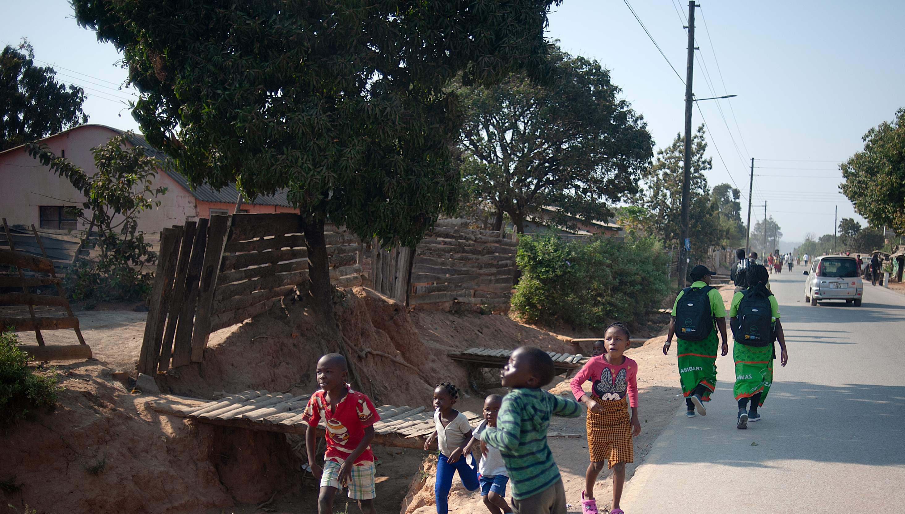
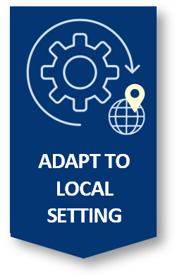
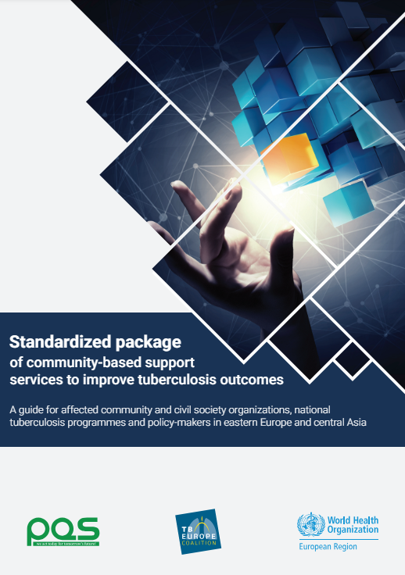
Community-based care
Health promotion
Health education
Contact screening
Active case finding in key populations
Patient care and support
Post-treatment social support and/or rehabilitation
Notes:
Community-based care for TB is best delivered by members of the same community who understand the circumstances of people affected by TB. This may include lay workers (community healthcare workers) who are trained to deliver other healthcare services within the community e.g., IMCI or persons who have completed TB treatment themselves (TB survivors). These community healthcare workers can be trained to deliver basic TB services and supervised by healthcare workers at the nearest health facility.
The WHO recommends a standardised package of healthcare services that can be delivered by community healthcare workers. This standardised package of care offers guidance to NTPs and governments for investing in and integrating community-based support services into essential TB care packages.
These services include
Health promotion to create awareness about TB in the community and to engage the community in TB activities e.g., active case-finding.
Health education to provide individuals at risk of TB and their family members with essential knowledge and information on TB symptoms and transmission, diagnosis, treatment options and infection control measures
Contact screening and identification of patients in need of treatment for latent TB infection to promote uptake of TB preventive therapy
Active case finding in key populations
Patient care and support including provision of treatment adherence support to ensure continuity of care and avoid interruption of treatment and care. Provision of care also includes identifying needs for additional support e.g., care for comorbidities and linking patients to the right care services for those needs.
Post-treatment social support and/or rehabilitation which includes linking patients to agencies and government programmes for social support and or skills training to enable them re-integrate into their communities after TB treatment.

Slide 25
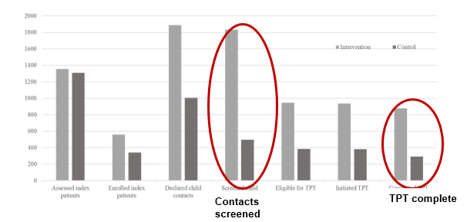
Evidence for community-based care : CONTACT
Facilities randomised to provide active community-based contact investigation (intervention) and compared to usual passive facility-based approach (control).
TPT initiation and completion significantly more common in intervention (community) arm compared to control (facility) arm:
80% v 62% OR 3.06 (95%CI: 1.24-7.53)
Intervention
Higher proportion of contacts screened for active TB:
82% v 47% OR 5.08 (95%CI: 2.17-11.9) with more TB cases detected
Control
Bonnet M, Vasiliu A, Tchounga BK, et al. Effectiveness of a community-based approach for the investigation and management of children with household tuberculosis contact in Cameroon and Uganda: a cluster-randomised trial. Lancet Glob Health. 2023 Dec;11(12):e1911-e1921. doi: 10.1016/S2214-109X(23)00430-8. Epub 2023 Oct 30. PMID: 37918417.
Notes:
The Community Intervention for Tuberculosis Active Contact Tracing and Preventive Therapy (CONTACT) study was the first randomised controlled trial to compare a community-based approach for contact screening and provision of TPT with the facility-based standard of care.
This study, which was carried out from October 2019 to January 2022, randomised communities in Uganda and Cameroon to either community-based approach to contact screening and management or a facility-based approach. The community-based approach consisted of symptom-based screening of all household contacts by community health workers at the household with referral of symptomatic contacts to local facilities for investigations. Initiation of TPT (3-month course of rifampicin and isoniazid) was done by a nurse in the household and home visits for TPT follow-up were carried out by community health workers.
The results of this study showed that community-based contact investigations and TPT management done by community health workers increased the coverage, initiation and completion of TPT among child contacts at high risk (aged <5 years, or aged 5–14 years with HIV).

Slide 26
Evidence for community-based care: CAST TB Uganda
Period: March - September 2022
Intervention area: countrywide.
Interventions:
Community mobilisation and sensitisation
Symptom screening for TB
Testing of presumptive TB with GeneXpert®
Linkage to care for those with confirmed TB
Household contact for people diagnosed with TB and TPT initiation for eligible contacts.
Results
Indicator | March | September
Screened for TB | 1,289,213 | 5,134,056
Presumptive TB among screened | 179,144 (13%) | 428,444 (8.3%)
Presumptive TB tested with Xpert | 134,595 (75%) | 297,532 (69.4%)
Persons diagnosed with TB | 4043 (2.3%) | 7144 (1.7%)
Persons started on TB Treatment | 3710 (91.8%) | 5942 (83.2%)
Turyahabwe S, Bamuloba M, Mugenyi L, Amanya G, Byaruhanga R, Imoko JF, Nakawooya M, Walusimbi S, Nidoi J, Burua A, Sekadde M. Community tuberculosis screening, testing and care, Uganda. Bulletin of the World Health Organization. 2024 Jun 6;102(6):400.
Notes:
The Community awareness, screening and testing for TB campaign was a biannual, national, community-based, active tuberculosis case-finding initiative which is implemented in March and September of 2022.
Key components include community mobilization and sensitization; voluntary symptom screening for tuberculosis and testing of presumed individuals for tuberculosis using Xpert® and linkage to care for those with a confirmed tuberculosis diagnosis. Contacts of peopled diagnosed with tuberculosis are identified and assessed for TPT.
The intervention resulted in 9652 TB cases found in that year. In a before and after analysis, improvements in case notification rates were observed. The case notification rate increased from 48.1/100 000 before the March cycle to 59.5/100,000 after the March campaign and to 71.6/100,000 after the September campaign

Slide 27
Private sector engagement

Slide 28
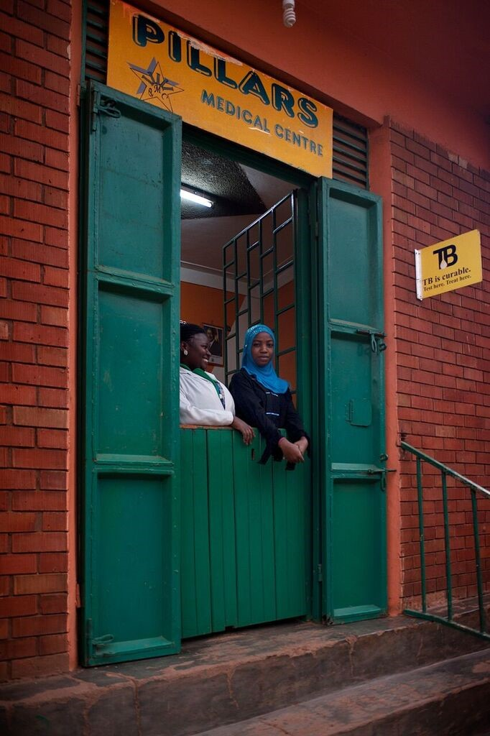
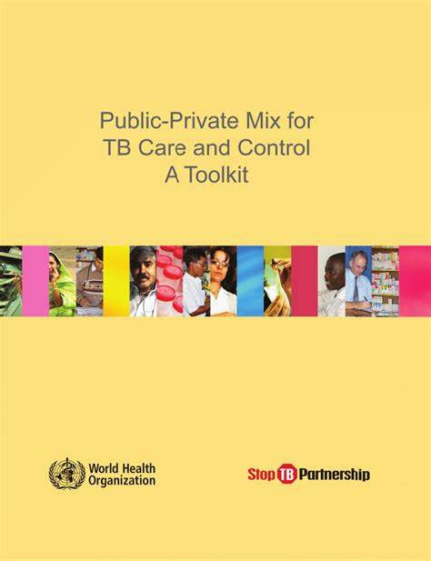
The role of the private sector
Notes:
In most high TB burden countries, the private health sector accounts for up to half of all outpatient care and is a common point of care for children presenting with common illnesses, such as cough, fever and diarrhoea. The private providers offer an important entry point to TB diagnosis and treatment for children and adolescents at risk for TB. The Roadmap towards ending TB in children and adolescents launched in 2023 prioritises the need to foster collaborative activities with different sectors, including with the private sector to optimise TB care.
Engaging the private sector increases access to TB screening, diagnosis and treatment initiation thus reducing transmission of TB that would otherwise occur due to diagnosis and treatment delays. Engaging the private sector also reduces catastrophic costs for families of children seeking TB care by facilitating referral to free NTP services or enabling privately managed children and adolescents to benefit from free programme procured medicines and diagnostics.
Given that a wide range of private healthcare providers exist in different settings, and that the services they provide vary. It is important for NTPs to map the different private providers in their settings and implement flexible models of engagement guided by the scope of services they provide. These may include health education to create awareness about TB, community TB screening, collection and transporting of non-invasive samples for diagnostic testing, treatment follow-up and use of digital technology for reporting.

Slide 29
Evidence for the role of the private sector
Period: January - December 2011
Intervention area: 54 private clinics and one private hospital in Karachi, Pakistan.
Interventions:
TB screening at private clinics and the outpatient department of hospital and by lay providers using an interactive algorithm on mobile phones
Referral of symptomatic patients for TB testing
Results:
Two-fold increase in case notification in the intervention clinics and hospitals compared to the twelve months prior to the intervention
Seven-fold increase in child TB notifications
Indicator | Private clinics | Hospital
Individuals screened for TB | 388,196 | 81,700
Proportion of presumptive TB among individuals screened | 6089 | 2405
No. of patients diagnosed with TB | 603 | 273
Khan AJ, Khowaja S, Khan FS, Qazi F, Lotia I, Habib A, Mohammed S, Khan U, Amanullah F, Hussain H, Becerra MC. Engaging the private sector to increase tuberculosis case detection: an impact evaluation study. The Lancet infectious diseases. 2012 Aug 1;12(8):608-16.
Notes:
Engaging private health providers in the provision of TB care services has been shown in to increase TB case notification and decrease the costs of seeking care.
In Pakistan, screening for TB at private clinics and hospitals resulted in a two-fold increase in case notifications in the intervention area compared to the control area while in Uganda, engagement of community pharmacies in TB screening and collection of sputum samples for TB diagnosis was associated Improved TB case notification and decreased costs of healthcare seeking.

Slide 30
Differentiated Service Delivery Models

Slide 31
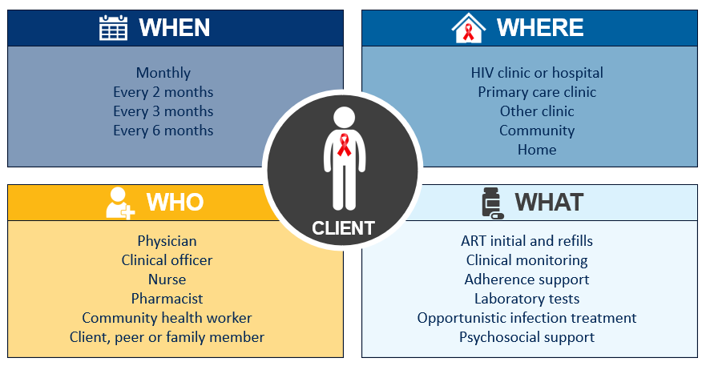
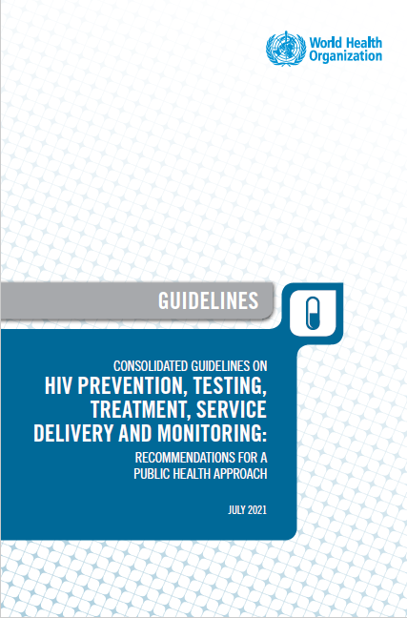
DSD models: considerations for people with TB, TB infection and special groups
Differentiated service delivery varies - different models respond to context-specific needs of different groups of people. These models aim to enhance person-centred services.
Notes:
Differentiated service delivery (DSD) is a person-centred approach that simplifies and adapts HIV services across the cascade in ways that both serve the needs of people living with HIV and optimise available resources in health systems. DSD varies when and where services are provided, who provides the services and which services are provided to create models of care that respond to different needs, contexts and groups of people.
DSD models for HIV treatment are largely divided into group or individual models which may be managed by healthcare workers or PLHIV. These models of care can be delivered at the health facility or in the community. Group models of differentiated care include health facility-based adherence clubs or community-based client-led ART delivery groups (CLADs) and community ART refill groups. Individual models include facility–based multi-month refills and fast track refills or home-based /community pharmacy refills. These models have been shown to efficiently deliver health care while maintaining relevant HIV treatment outcomes e.g., viral load suppression.
DSD models can and should be extended to TB treatment services and provision of TB preventive therapy to enhance their person-centredness. They should be also extended to people with both HIV and TB though in many high TB-HIV burden countries, persons living with HIV and having TB are often excluded. However, the WHO policy on collaborative TB-HIV activities recommends the delivery of integrated TB and HIV services, preferably at the same time and same location, to improve access to good-quality services. It is important that the NTP works closely with the national HIV/AIDS programme to ensure children and adolescents with HIV-associated TB can access these patient/person-centred approaches.
Delivery of TB care services through DSD models requires adaptations at multiple levels of the health system, including national, facility and community levels. This includes adaptation of guidelines, capacity-building, adjustments in logistics management, alignment of existing recording and reporting tools, and community engagement.

Slide 32
Conclusion

Slide 33
Conclusion: key learning points
Decentralised care models aim to bring TB services closer to where children and adolescents seek care and where families that care for these children live.
Decentralised TB care services should be integrated with other care services, including private sector services in order to increase the reach.
Community healthcare workers are a key resource for delivery of some of the components of decentralised care.
Successful delivery of decentralised care requires careful planning by NTPs to ensure that policies, human resource and logistical supplies are in place.
TB care services should be integrated into other people-centered models of care e.g., DSD models to ensure equitable access for children and adolescents co-infected with TB and HIV.

Slide 34
References
Bonnet M, Vasiliu A, Tchounga BK, et al. Effectiveness of a community-based approach for the investigation and management of children with household tuberculosis contact in Cameroon and Uganda: a cluster-randomised trial. Lancet Glob Health. 2023 Dec;11(12):e1911-e1921. doi: 10.1016/S2214-109X(23)00430-8. Epub 2023 Oct 30. PMID: 37918417.
Dongo JP, Graham SM, Nsonga J,et al. Implementation of an Effective Decentralised Programme for Detection, Treatment and Prevention of Tuberculosis in Children. Trop Med Infect Dis. 2021 Jul 14;6(3):131. doi: 10.3390/tropicalmed6030131. PMID: 34287383; PMCID: PMC8293469.
Grimsrud A, Bygrave H, Doherty M, Ehrenkranz P, Ellman T, Ferris R et al. Reimagining HIV service delivery: the role of differentiated care from prevention to suppression. J Int AIDS Soc. 2016;19:21484.
Hanson CL, Osberg M, Brown J, et al. Conducting Patient-Pathway Analysis to Inform Programming of Tuberculosis Services: Methods. J Infect Dis. 2017 Nov 6;216(suppl_7):S679-S685. doi: 10.1093/infdis/jix387. PMID: 29117350; PMCID: PMC5853893.
Standardised package of community-based support services to improve tuberculosis outcomes. A guide for affected community and civil society organizations, national tuberculosis programmes and policy-makers in eastern Europe and central Asia. Copenhagen: WHO Regional Office for Europe; 2023. License: CC BY-NC-SA 3.0 IGO.
WHO operational handbook on tuberculosis. Module 5: management of tuberculosis in children and adolescents. World Health Organization, Geneva, 2022
WHO Roadmap towards ending TB in children and adolescents. Third Edition, November 2023.
World Health Organization. Public-private mix for TB care and control: a toolkit.
Zawedde-Muyanja S, Nakanwagi A, Dongo J, et al. Decentralisation of child tuberculosis services increases case finding and uptake of preventive therapy in Uganda. Int J Tuberc Lung Dis. 2018 Nov 1;22(11):1314-1321. doi: 10.5588/ijtld.18.0025. PMID: 30355411; PMCID: PMC7237826.

